Slide 1


21AIE213 - ROBOTIC OPERATING SYSTEMS & ROBOT SIMULATION
PROJECT PRESENTATION
TEAM - 11

Slide 2

Team Members
Karthikeyan M – CB.EN.U4AIE20029
Rishekesan S.V-CB.EN.U4AIE20058

Slide 3

01
Introduction
03
Procedure
02
Alphabet Drawing Manipulator
04
Output
Table of Contents
05
Simulation

Slide 4
Introduction
01

Slide 5
AIM
Our aim is to simulate a robot that draws specific alphabets with having its respective co-ordinates and simulate it in the GAZEBO environment. We create a planar robotic manipulator to write the letters A, T, H, E, L and F. The system takes an alphabet to write as input and returns the alphabet drawn with our robot. In our project we simulate different alphabets based on user input.

Slide 6
Alphabet Drawing Robotic Manipulator
02

Slide 7
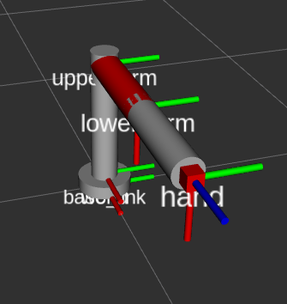
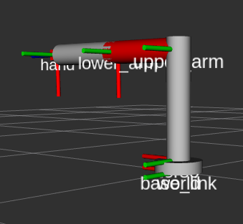
Robotic planar manipulator
The manipulator that we use is 4 DOF 3R planar manipulator having 4 joints namely wrist , hip, shoulder, elbow joints namely.
The degree of freedom is 4 because three for the different links , and one joint for the end effector .
Based on the transformations we make we can draw the alphabet based on user input.

Slide 8
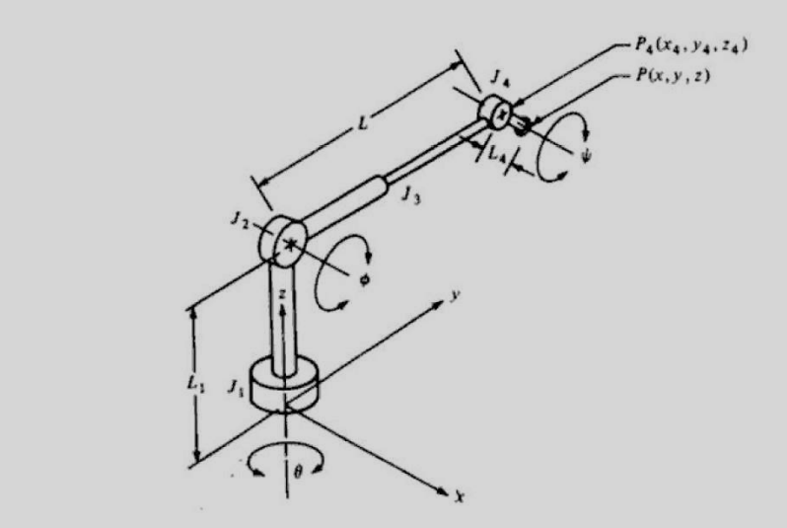
The manipulator has 4 degrees of freedom:
Joint 1 (type T joint) allows rotation about the axis;
Joint 2 (type R) allows rotation about an axis that is perpendicular to the z axis,
Joint 3 is a linear joint which is capable of sliding over a certain range
Joint 4 is a type R joint which allows rotation about an axis that is parallel to the joint 2 axis.

Slide 9
From the base to the end-effector, a coordinate frame is assigned to each robot link. Along with the robot's links, other nearby objects (such as a camera mounted on a wall, a ball that it must pick up, the end-goal-pose, effector's etc.) are given coordinate frames.
These frames will inform us of the frame's orientation and position in relation to other frames. The Transformation matrices are used to determine the coordinates of these frames. When the robot moves or other objects move, these frame coordinates must be updated.
Accurate control of manipulator depends on precise control of joints . Control of joints depends on forces and inertias acting on them

Slide 10
Procedure
03

Slide 11
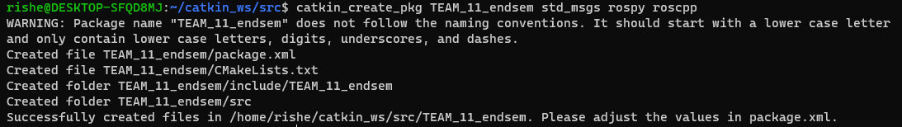
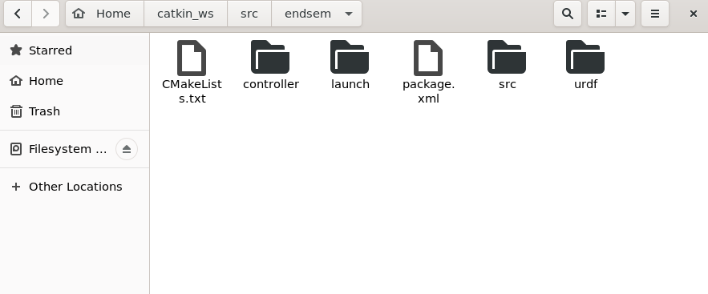
STEP 1
Create a package with a list of dependencies
These folder are created using -mkdir within the package

Slide 12

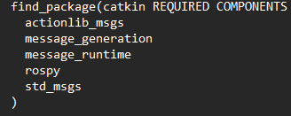
For building actions, include actionlib_msgs among the dependencies:
actionlib_msgs defines the common messages to interact with an action server and an action client.
Rospy is a ROS client library written entirely in Python. Python programmers can use the rospy client API to quickly interact with ROS Topics, Services, and Parameters.

Slide 13
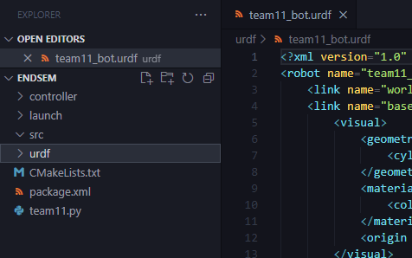
We used visual –code IDE for creating the urdf and respective py scripts
The respective URDF files and team11.py has been created.
So, what's a URDF?
A C++ parser for the Unified Robot Description Format (URDF), an XML format for representing a robot model, is included in this package.
The parser's code API has been reviewed and will remain backwards compatible in future releases.

Slide 14
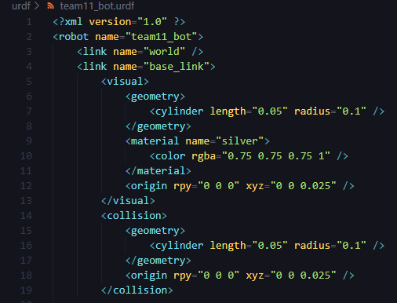
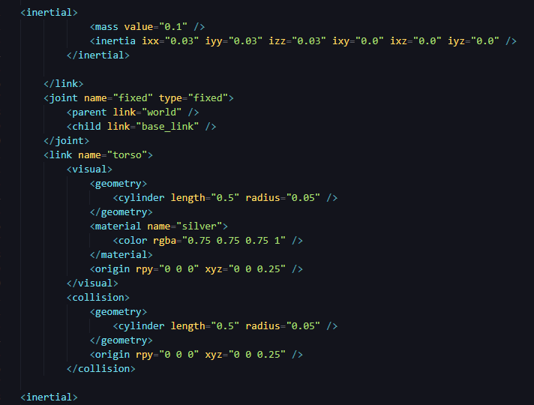
Defining the first link of radius 0.1 and length 0.05
Inside the inertial tag The 3x3 rotational inertia matrix is specified with the inertia element. Since this is symmetrical, it can be represented by only 6 elements, as such.
All we need to do to add dimensions to our connections is specify the offset from a link to the joint of its children. To do so, we will add the origin field to each of the joints.
To simulate the robot in a program like Gazebo, we must define a collision tag.

Slide 15
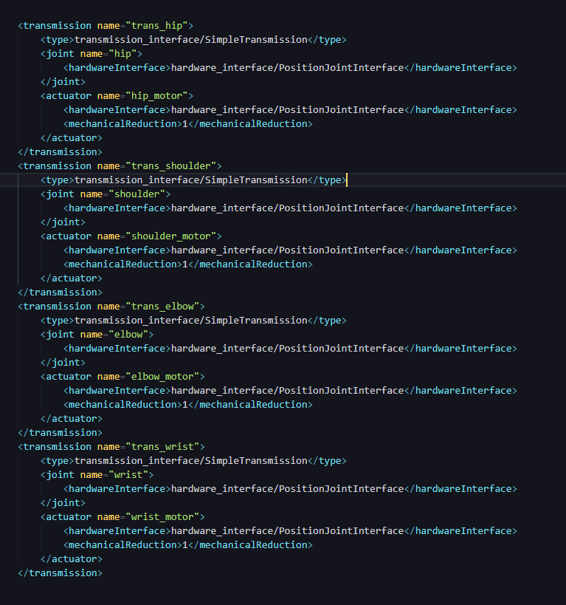
The transmission element is a URDF robot description model extension that describes the relationship between an actuator and a joint.
Hardware_interface package, this package wraps existing raw data
Connecting and linking all the four links (Wrist,Hip,Shoulder,Elbow)

Slide 16
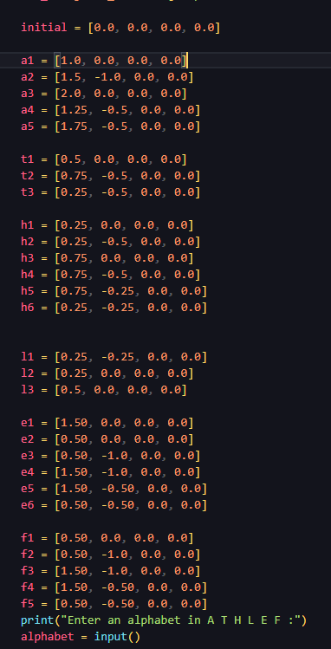
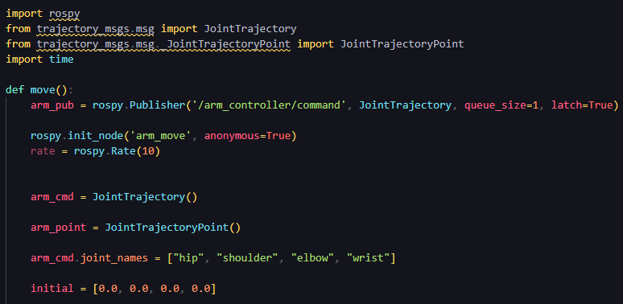
Inserting the respective letter and its co-ordinates
Messages for defining robot trajectories are defined in this package. These messages are also the foundation for the majority of the control msgs actions.
For Example : Letter(A) the co-ordinates are a1,a2,a3,a4,a5 are the transformation steps required for drawing alphabet - A

Slide 17
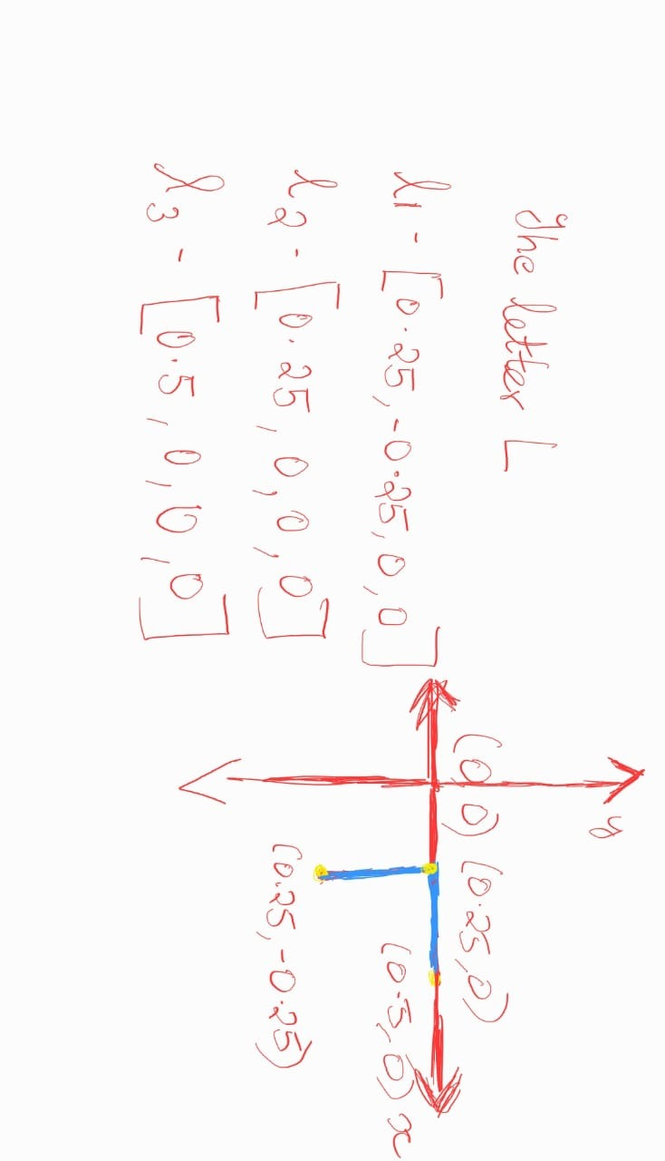
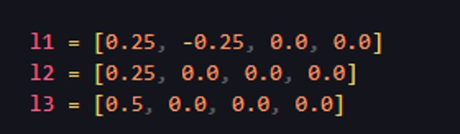
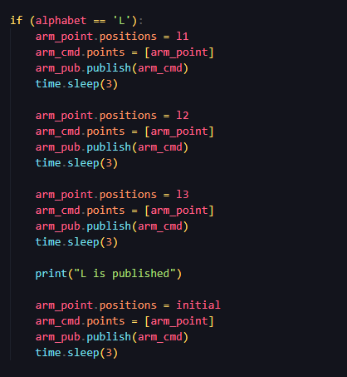

Slide 18
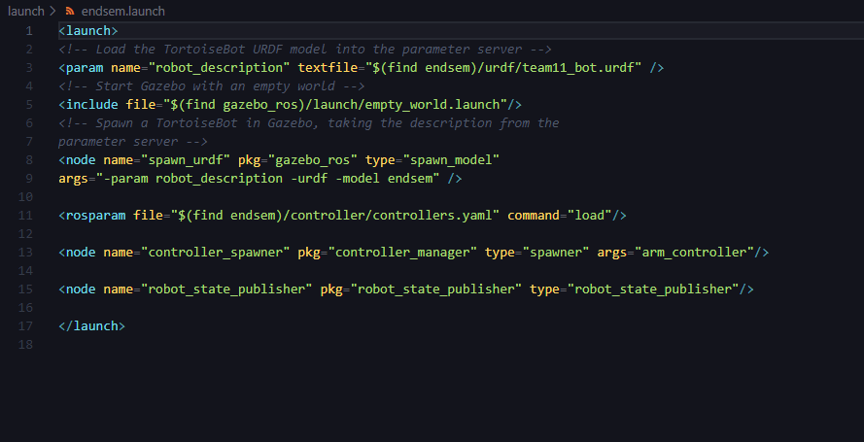
Creating a Launch file for the model
Launch files employ a particular XML format and have the extension. Launch.
A pair of launch tags must separate the contents of a launch file.
They offer an easy approach to initialize numerous nodes, a master, and other startup needs like specifying parameters.

Slide 19
Output
04

Slide 20
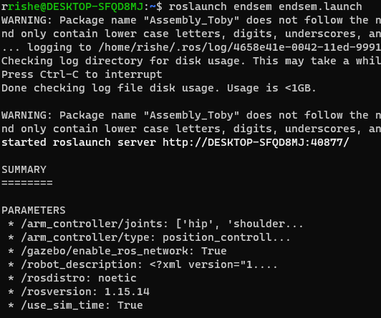
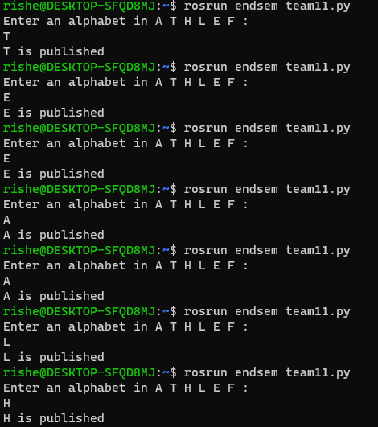
Terminal 1
Terminal 2​

Slide 21
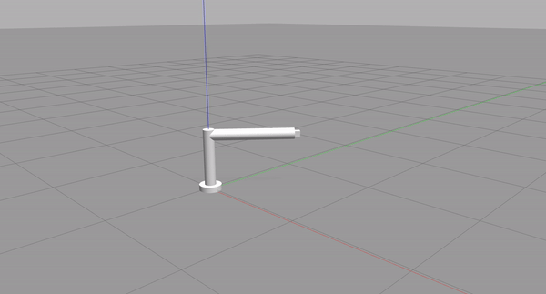
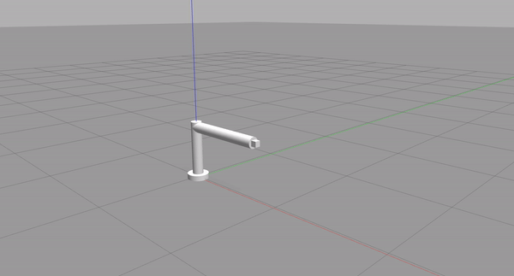
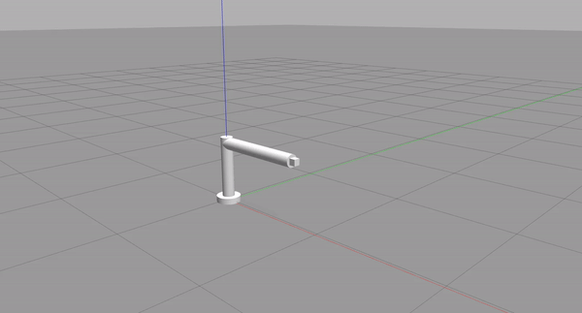
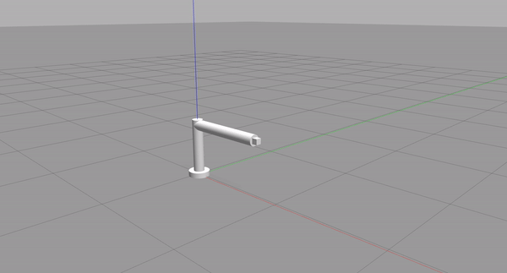
Letter A
Letter H ​​​
Letter L ​​
Letter E ​

Slide 22
Simulation

Slide 23
Thank you !

